Slide 1
Code Slayer
Tic Tac Toe Game
By Elvis, Akshay, Luis, Stephanie, Nick
Notes:
1
1

Slide 2
Role of each member
Elvis Jimenez | Team lead, developer and architect of the GUI interface.
Akshay Patel | Sub team lead and architect of the single player mode (PvP).
Luis Oropeza | Tester and secretary
Stephanie Reyes | Secretary and Tester.
Nick | Architect of the AI.
Notes:
2
2

Slide 3
Preliminary Requirements

Slide 4
Modification History
9/9/16 | The product design layout has been developed
9/16/16 | The product design layout has been improved with features.
9/23/16 | The coding has begun and a 5X5 board has been created
9/30/16 | The product has the single or multiplayer feature
10/3/16 | Product is able to play Human VS Human
10/19/16 | Product has an easy, medium, and hard feature.
10/24/16 | AI has initialized
11/1/16 | AI is complete
11/15/16 | Main menu has been started
11/21/16 | Main menu completed and started to user login

Slide 5
Risks
Risk Management Activity | Comments
Time constraints risk | If a member start to fall being the team lead have to pick up the slack to make up the time.
Data loss risk | All team members have a back of the data for this project. GitHub has a version of our data as well.
Members leaving risk | If a team member leave the roles will need to be divided among the rest of the team members.
Equipment malfunction risk | All members have a computer or a way to get a computer to perform project presentation needed.
Not enough logged of the codding | Any and all team members who have the knowledge of C++, would instruct the team member/s in question.
Poor communication risk | The group has set up a slack, group me, and email to pass along any message.

Slide 6
Domain Knowledge
Glossary
Term | Definition
5x5 Tic Tac Toe | A game can be played with two players using X and O signs. The player who succeeds in placing four of their marks in a horizontal, vertical, or diagonal row wins the game.
GUI(Graphical User Interface) | Two people can operate it using keyboard and mouse
Platform | OS based on the which software the game is running
SDL | Extensive library for C++
Visual Studio | Integrated development environment for implementing the code
One Player | A player play against the computer
Multi Player | More than one player can play with each other.
Difficulty Level | In one player, player can play it in easy, medium and hard levels.

Slide 7
Acronym | Meaning
AI | Artificial Intelligence
GUI | Graphical User Interphase
PvP | Player versus Player
PvE | Player versus Environment or Computer
TTT | Tic Tac Toe

Slide 8
Game set up
Goals of actor | To play Tic-Tac-Toe casually during one’s free time.
Tasks | Player 1 starts the game initially. At this point the software should create the grid so the player can choose whether to play against the AI or against another human player. Next, the player chooses the difficulty or skill level to start the actual game. At any point user is able to view score.
Preconditions | Empty grid, in other words a “New” game.
Exceptions | If a game is in progress and user want to start a new game a pop up message will show up to confirm a start of a new game. Which will be consider a lost for current player.
System change/production | At any point user is able to change from single mode to multi mode and chose from any of the difficulty levels

Slide 9
Use Case 1
Goals of actor | User registers to play game or play as a guest
Task | Initially register a user name to start playing the game
Preconditions | No user name is registered
Exceptions | Error message is shown if name is already registered
Variation of action interactions | User can choose to create a user name or play as a guest
System change/production | Guest will be deleted once game is closed

Slide 10
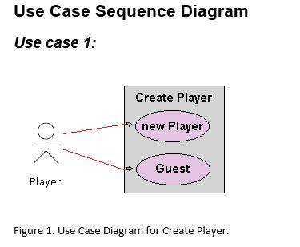
Use Case: 1 Create player or guest for Tic Tac Toe game

Slide 11
Continue…
General Description
This enables for user to create a new player or sign in as a guest.
Use Case 1: Creating a player
Brief Description Allows a new player to sign in with player name.
Step-by-Step Description Player inputs name and signs in. Player will be allow to see the record of wins and losses.

Slide 12
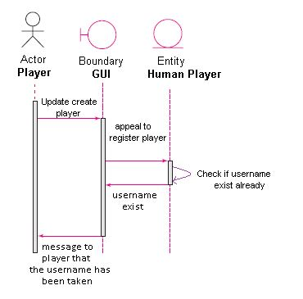
Continue…
Sequence Diagram

Slide 13
Continue…
Use case 1: Player name already exist (anomaly 1)
Brief Description Player username already exist.
Step-by-Step Description Player uses name that already exist Player will get a message that informs player that the username is already taken.

Slide 14
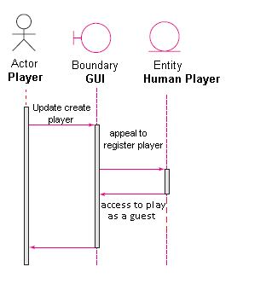
Continue…
Sequence Diagram

Slide 15
Continue…
Use case1: Player plays as a guest. (Anomaly 2)
Brief Description Player plays as a guest.
Step-by-Step Description Player does not need a username and plays as a guest. Guest player will not create a report of wins and losses.

Slide 16
Use Case 2
Goals of actor | User chooses to display game history
Task | Display all user scores that have played the Tic-Tac-Toe
Preconditions | Any game in progress is temporarily blocked and only the score can be seen
Exceptions | Current game play is covered and not able to move until score page is closed
Variation of action interactions | User able to display score any time during the game
System change/production | Score can only be view not modified.

Slide 17
Use Case 3
Goals of actor | Multi-Player selection
Task | User selects to play multi-player mode
Preconditions | Only to be used in the software while playing against another Human.
Exceptions | Multi-Player Mode is only used against human vs human
Variation of action interactions | User choose who want to go first or randomized who’s player one or two. Users have to enter there own stones
System change/production | User name may change according to player.

Slide 18
Use Case 4
Goals of actor | Single player selection
Task | Game Play is to play against AI when bored. User will have to create an account or plays as a guest. User has to chose difficulty in level as well
Preconditions | Only to be used in the software while playing against AI.
Exceptions | Only one player can play at a time against the AI.
Variation of action interactions | User will be able to chose difficulty level and to choose to play as a guest, create a user name, or logging as an existing user.
System change/production | Depending on level the game becomes challenging.

Slide 19
USE CASE 5
Goals of actor | Selecting difficulty level
Task | To assign a certain level of difficulty before a new game starts.
Preconditions | Player has to choose a skill level of either easy, medium or hard in order to start playing the game.
Exceptions | Can only be used against the AI
Variation of action interactions | AI acts differently according to level selected
System change/production | AI algorithm change according to level selected.

Slide 20
Use Case 6
Goals of actor | End of Game Play
Task | Exits the game being played, or Play a new game , being multiplayer or single mode
Preconditions | The game play has to have finished either with a winner or a draw giving the user/s an option to start a new game or end the game
Exceptions | Confirmation of quitting game at any time is needed. Keeping in mind if current game has not reach an end the user who had the last turn will be consider the loser
Variation of action interactions | User/s can quit or start a new game at any time but have to confirm action
System change/production | If chosen to quit everything will close. If action is taken in the middle there will be consequences.

Slide 21
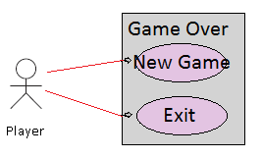
Continue…
Use Case Diagram for Game Over

Slide 22
Continue…
General Description
This enables for user to start a new game or exit the game.
Use Case: Starting new game
Brief Description Allows a player to start a new game.
Step-by-Step Description Player clicks new game. Player will start a new game.

Slide 23
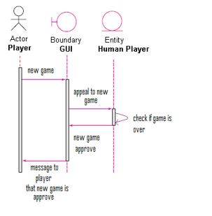
Continue…
Sequence Diagram

Slide 24
Continue…
Use case: Player chooses new game (anomaly 1)
Brief Description Player chooses new game.
Step-by-Step Description Player chooses to start a new game. Player will get a message that informs player that new game has begun.

Slide 25
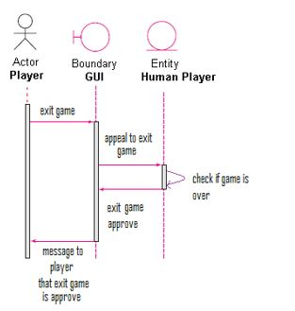
Continue…
Sequence Diagram

Slide 26
Continue…
Use case: Player chooses to exit game. (Anomaly 2)
Brief Description Player exits game.
Step-by-Step Description Player does not want to start a new game and exits game. Player will not start a new game and the game will close down.

Slide 27
Non-Functional Requirements
Cost Constraints:
The project has a budget of $0.00. No further maintenance costs will be required in the future.
Reliability:
The software has a shelf life of 2 years after its final release. Updates will provided until its requirement
Time Constraints:
The time constraints are finding time to accommodate everyone’s availability to meet. Also, we need to organize adequate allotted time to completing the project. The software will be available by December 2016.

Slide 28
Current Developments
Implementing all functionalities of game usage in the classes.
Code completion for storing user score
Implementing all use cases in testing iterations
Notes:
28
28

Slide 29
Pending Developments
Implementation of database for game history
Implementation of guest sing in.
Notes:
29
29

Slide 30
Types of Testing
Glass-box testing: Branch Testing
Execution based testing
User Interaction testing
Notes:
30
30

Slide 31
Glass-box Unit Testing
Branch Testing
Begin as an existing player or guest.
Game playing mode: Player vs AI.
Level of difficulty selection
Selection of user that begins to play
Notes:
31
31

Slide 32
Execution Based Testing
Testing for the following components in our program:
Reliability
Robustness
Performance
Utility
Correctness

Slide 33
User Interaction Testing
Start game
Display score
Select difficulty level
Check if board is full
User adaptability to GUI
Notes:
33

Slide 34
Testing Cases
Menu options display
Scoreboard reliability
AI Difficulty and tendencies
User ability to go first
Move overwriting
AI and General Game Performance
Piece Swap
Compatibility

Slide 35
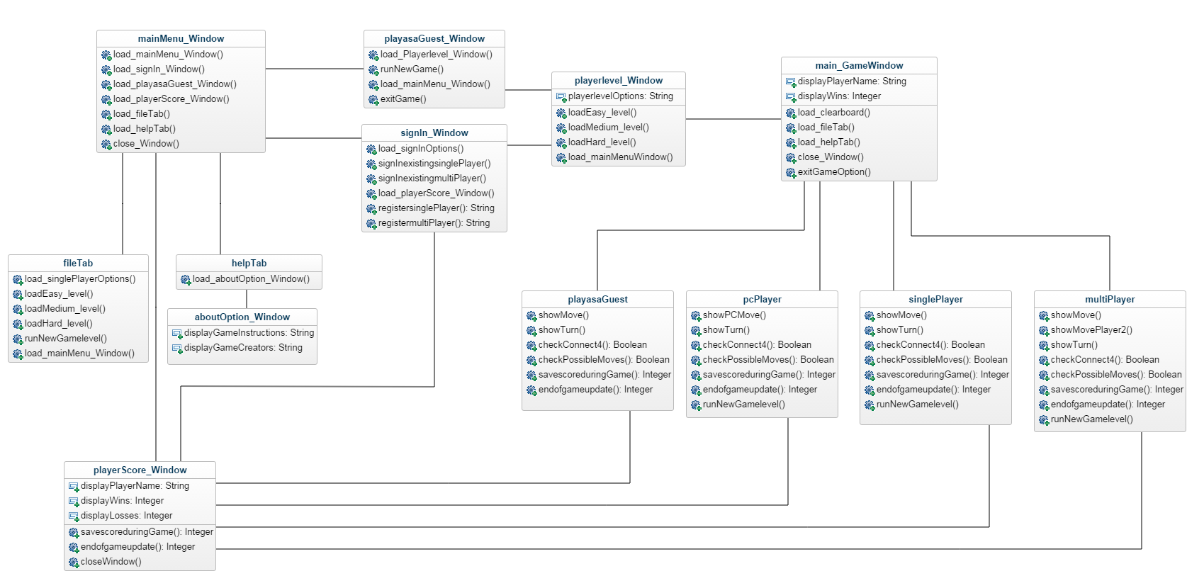
Class Diagram

Slide 36
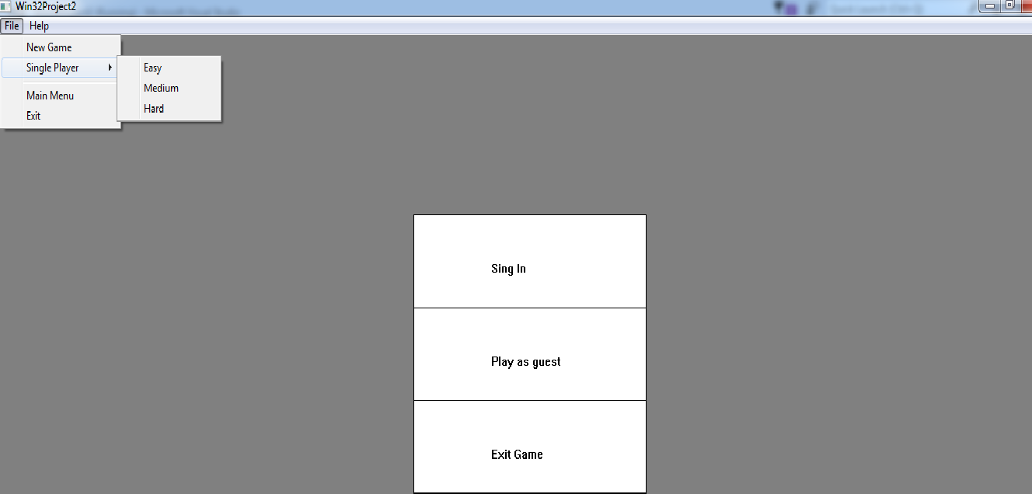
Main Menu

Slide 37
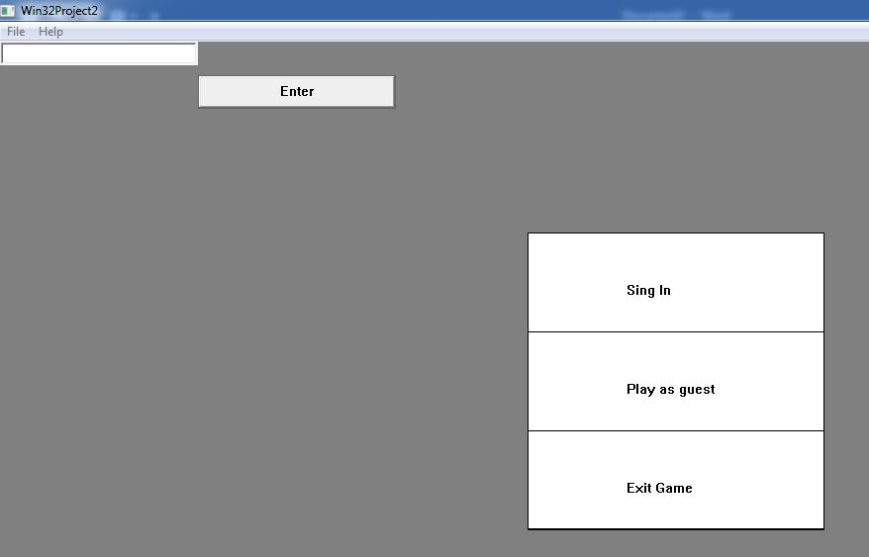
Continue…

Slide 38
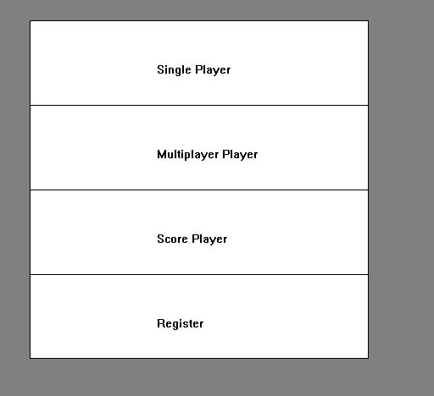
Continue…

Slide 39
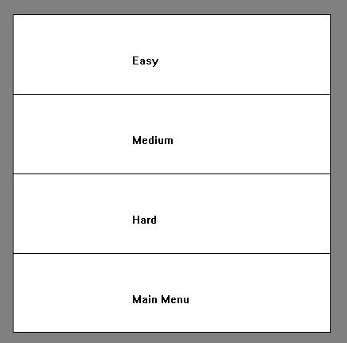
Continue…

Slide 40
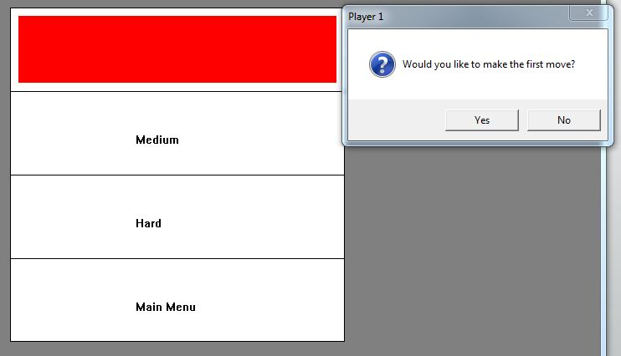
Continue…

Slide 41
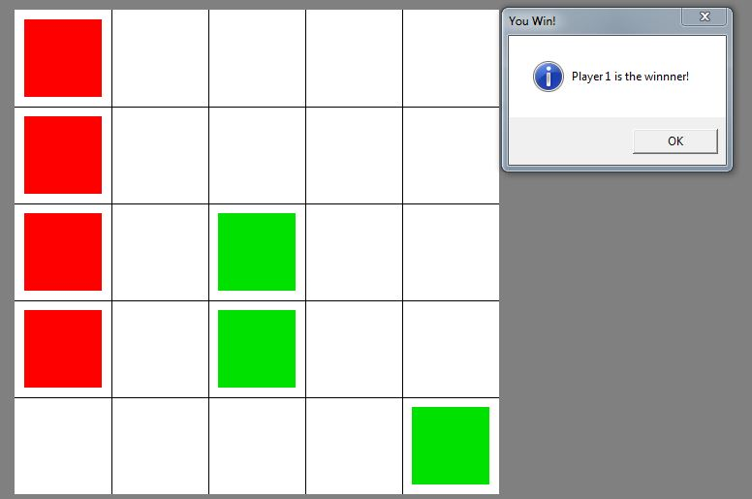
Continue…
After playing with AI in easy mode

